Slide 1
Evolving Legacy Code
Notes:
<>

Slide 2
Who we are…
Rachel Cheng
Software Engineer III, F5 Networks
Graduate Student, Georgia Tech
Alumni, The Evergreen State College
Young and naïve
Michael VanLoon
Principal Software Engineer, F5 Networks
C++ Nerd
Old and wise

Slide 3
F5 Overview
F5 Networks
80% of internet traffic goes through an F5 device somewhere*
F5 does network load balancing and MUCH more
We do health monitoring for evaluating the health of network servers
*May not actually be true, but it sounds good!

Slide 4
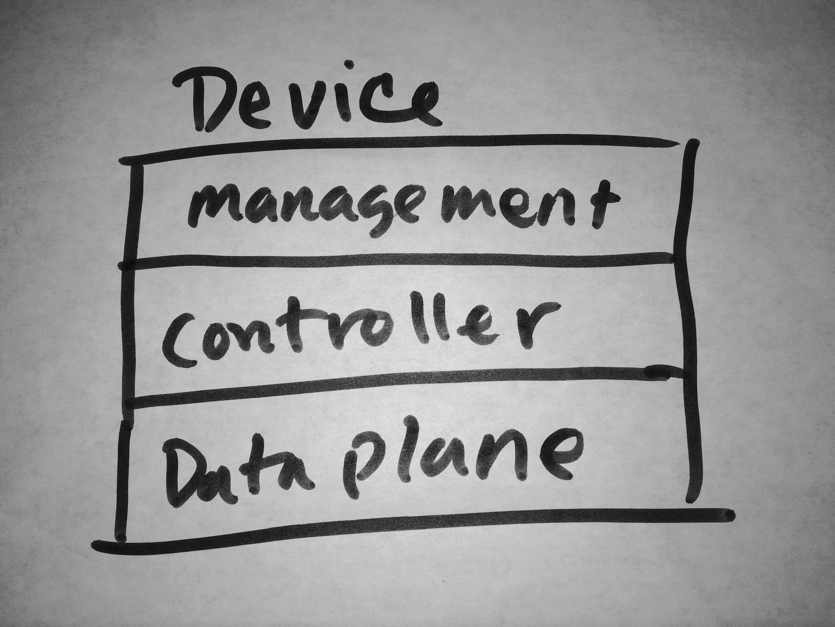
F5 Overview
Three layers of abstraction
Notes:
The networking device roughly has 3 layers of abstraction.
Dataplane: pushes the packets, implements the protocols
Controlplane: dictates how packets are going to be pushed, manages configuration, and provides services such as clustering, failover, sync, monitoring, and more…
Management: is GUI, APIs, and other ways users can interact with the device.

Slide 5
New Monitoring Subsystem
New API! 100x Performance! C++11! New Shiny!
Notes:
We want a new modern monitoring system, with all these fancy features, awesome code, and so we nuked it entirely and replaced it with something else.

Slide 6
New Monitoring Subsystem
New API! 100x Performance! C++11! New Shiny!
Notes:
But no… we didn’t actually do that. What we’ll really discuss today is how we evolved and continue to evolve the code.

Slide 7
“...the single worst strategic mistake that any software company can make: they decided to rewrite the code from scratch”
www.joelonsoftware.com
Notes:
And Joel on Software, said it wonderfully…
You give your competitors years head start on beating you, you have an opportunity cost, you have to still maintain the old product, you ship a minimally viable product – it’s not a wise idea to start from scratch.
Joel also writes about examples that include Netscape amongst others who have lost their competitive edge.

Slide 8
Motivations
Architectural problems
Difficult to maintain
Ugly code
Hard to extend
Poor performance
Technical debt
Notes:
However, we had good reasons why we wanted to scrap the whole thing…
Arch Problems: make it hard to add new functionality, difficult to write tests for.
Difficult to maintain: Legacy code has a lot of code that doesn’t conform to internal standards, code flow, or frameworks. The functional constraints unclear.
The code is ugly and hard to read.
Degrading performance is usually a another big trademark of legacy code
Technical debt, a term we’re all familiar with, shows up in the form of difficulty in adding new functionality, performance, and maintenance.

Slide 9
Code Characterization
Age of code: 14 years
Lines of code: ~30,000
Other subsystems impacted: 8
Monitoring performance: sub-optimal
Functional Test Coverage: per-protocol
Unit Test Coverage: 0
Notes:
Just to give you an idea of what we’re dealing with, the monitoring subsystem is the oldest piece of code on the device, and because other frameworks have outpaced in development, this code tended towards legacy over time. Custom code was built around to cope with new GUI frameworks and middleware frameworks, and so it became increasingly harder to maintain and add new features over time. <more below>
30,000 is a lot of lines of code for such a subsystem, but I should point out that 35% of the code or more just deals with the custom code to fit legacy code into more modern code, and is not actually code that implements the system. <more below>
Another aspect not listed here was that it was originally written in C, <> and then some developers came in, added some C++, and left fast before they could be tagged as a subject matter expert. Then somebody else would come in, add some different style of C++ on top of it. Reading the code, you can see this archeology, and it takes too long to understand and competently maintain.

Slide 10
What do?
Sell the long term vision in pieces
Evaluate for components of work
Attach business value to each item
Notes:
We can’t scrap the entire subsystem, so what can we do? We sell the long term vision in pieces, and productize it for our customers. That way, we evolve the code in pieces while still making forward progress in the product.
In addition to just the code, we also think about other tangentials, such as process, testing, and code reviews.

Slide 11
Example 1: Data Structures
struct monitor {
int fd;
monitor_type type;
int (void *) send();
int (void *) recv();
int state;
};
Notes:
So let’s look at some hypothetical code.
Following the metaphor, the subsystem was originally written in C so here I have a struct that represents a monitor.
At one point it was fine, suitable for requirements at the time, supporting and describing the basis for 2 maybe 5 protocols, and it had only a handful data members.
Each instance of this structure is passed by reference around some C functions, traversing through a tree-like decision tree with the tag dispatching it down certain branches,
It does its thing, saves some important state, like up/down/pending, the implementation of the protocol through send/recv, storing the file descriptor during runtime.

Slide 12
Example 1: Data Structures
struct monitor {
int fd;
monitor_type type;
int (void *) send();
int (void *) recv();
int state;
// +200 data members!
};
Notes:
Fast forward 10 years, and the product now supports over 30 protocols, and the struct’s now grown by say over 200 data members. This becomes untenable.
Not many attributes were re-usable, it’s not clear what members belong to what protocol, it’s not clear what can be modified and when, and it becomes increasingly harder to add new protocols as the tree gets larger.
At this point, that tree doesn’t resemble an interface, with many sub-functions and routines that cut out of the loop early.
Some new monitoring types such as Diameter might want to re-use the same file descriptor for multiple interactions, so it goes around the usual flow.
You can have multiple data members with similar names, like “ip address a”, “ip address b”, “ip address c”, and it’s not obvious which IP address data member is used for transparent probing, n-path routing, or IPIP.
Function pointers isn’t as straightforward and it’s hard to tell what’s being called.
In legacy code, learning the code often involves learning the history of changes. You infer the history and the rationale from tracing the program laboriously.

Slide 13
What do?
Option 1: Create an external system that makes it easier to add new items, bolted on the old framework
Option 2: Change the data structure and use a prototype design pattern
Notes:
So, if we stop here, we can wonder.. What should we do about this? Customers notice huge memory usage when upgrading from a really old version to a newer version, and the host operating system doesn’t give us much resources to run in the first place. In addition, we’re interested in making it easier to add new protocol support, and we start looking at some options.
One might be to add yet another layer, a quick patch that accomplishes this goal in part. We would push developers outside, where they can write their binary in a new clean space, provide some hooks to the old system, and call into it from the old framework. This is fast simple answer and keeps people from having to learn the guts.
But… if you already have too many of this layers, you might consider something deeper, such as changing the data structure with minimum impact to the underlying system.

Slide 14
Example 1.b: Data Structures
Prototype Design Pattern
Separate configuration from behavior
Abstract type for protocols
Data specific to monitor type isolated from other types
Notes:
We can already think of object-oriented ways of doing this, such as class hierarchies with a base class of common elements, or a prototype design pattern. We could separate the configuration from behavior, …

Slide 15
Example 2.c: Class Design
class MonitorSubscriber {
public:
int recv_msg(…);
map<int> routeDomains;
void distribute();
const char * get_hostname();
int set_status_change(…);
};
MonitorSubscriber g_MonitorMgr;
int send_messages(…);
Notes:
Another opportunity is in class design.
A subscriber we usually think of as something that receives a transaction, maybe we get some callbacks during processing, and we have some transaction processing code, and other functionalities.
Again, here at one point, this class started as a typical subscriber class, and over time it seems that it was just a convenient place to put new things in it. The end result confuses the intent of the original code.

Slide 16
Example 2: Performance
Where are your biggest opportunities?

Slide 17
Example 2: Performance
What is our performance?
What are our limits?
Maybe we should test and find out…

Slide 18
Example 2: Performance
Limit the number of syscalls
List -> Hash / Map

Slide 19
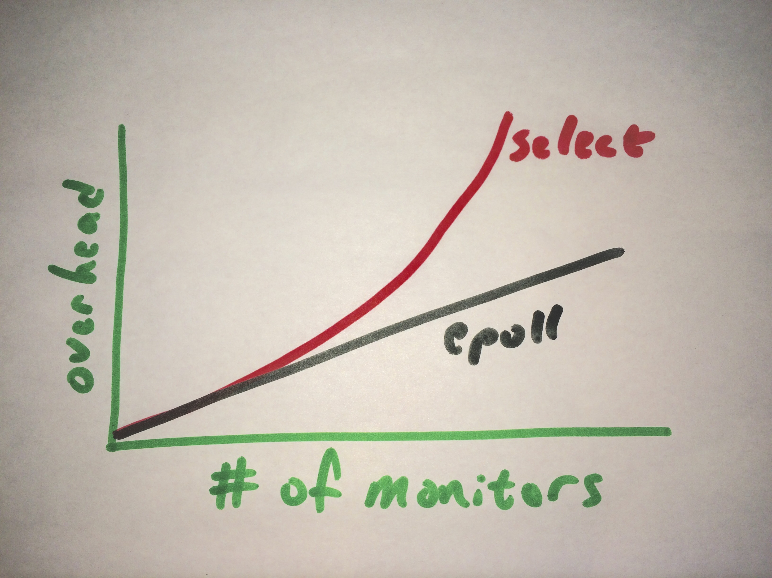
Example 2: Performance
From select() -> epoll()
CPU Usage | 15% improvement
HTTP/TCP monitor | 4000
HTTPs monitor | 2000
Notes:
Terms of performance measurements
15% improvement on CPU usage for HTTP and TCP monitors versus HTTPs monitors
O(N)

Slide 20
Example 2: Performance
Multi-process
Break single process load across multiple identical processes
Performance increase is near-linear
4x processes result in nearly 4x the load ceiling

Slide 21
Example 2: Performance
Multithreading
Advantages:
Finer-grained scheduling
Lower latency; more responsive
Disadvantages:
Code is more complex, harder to write, harder to get right
Potential wasted idle time blocked on locks

Slide 22
Others…
Bringing up the legacy code to standard frameworks usage
Applying safe/modern C++ standards
Notes:
So we walked through a couple of itemized pieces that can be evolved and provide benefit to our internal and external customers. Some other examples of pieces include
Bringing up legacy code to standard frameworks usage. As mentioned before, legacy code tends to happen when development of underlying frameworks outpace older code, effectively outdating it.
Another is by applying modern C++ standards, especially ones that reflect code safety. This was well covered already by several talks this year, including Bjarne, Herb and Gwendolyn, so I’m not going to get into it here.

Slide 23
Example 3: Testing
Working with Legacy Code
Notes:
Testing: Unit testing didn’t really seem to be a thing in the early 90s, and historically, the code only had functional testing that exercised each protocol to some extent. We didn’t have good cross-functional testing, perhaps because functionalities such as synchronization, distributed monitoring, and others were developed many years later, and the monitoring subsystem has been neglected.
It is not uncommon for legacy code to lack unit-level testing, and because the code design doesn’t contemplate unit testing, it usually also doesn’t have clean interfaces that would make it easy to mock out things such as networking code or other runtime dependencies.

Slide 24
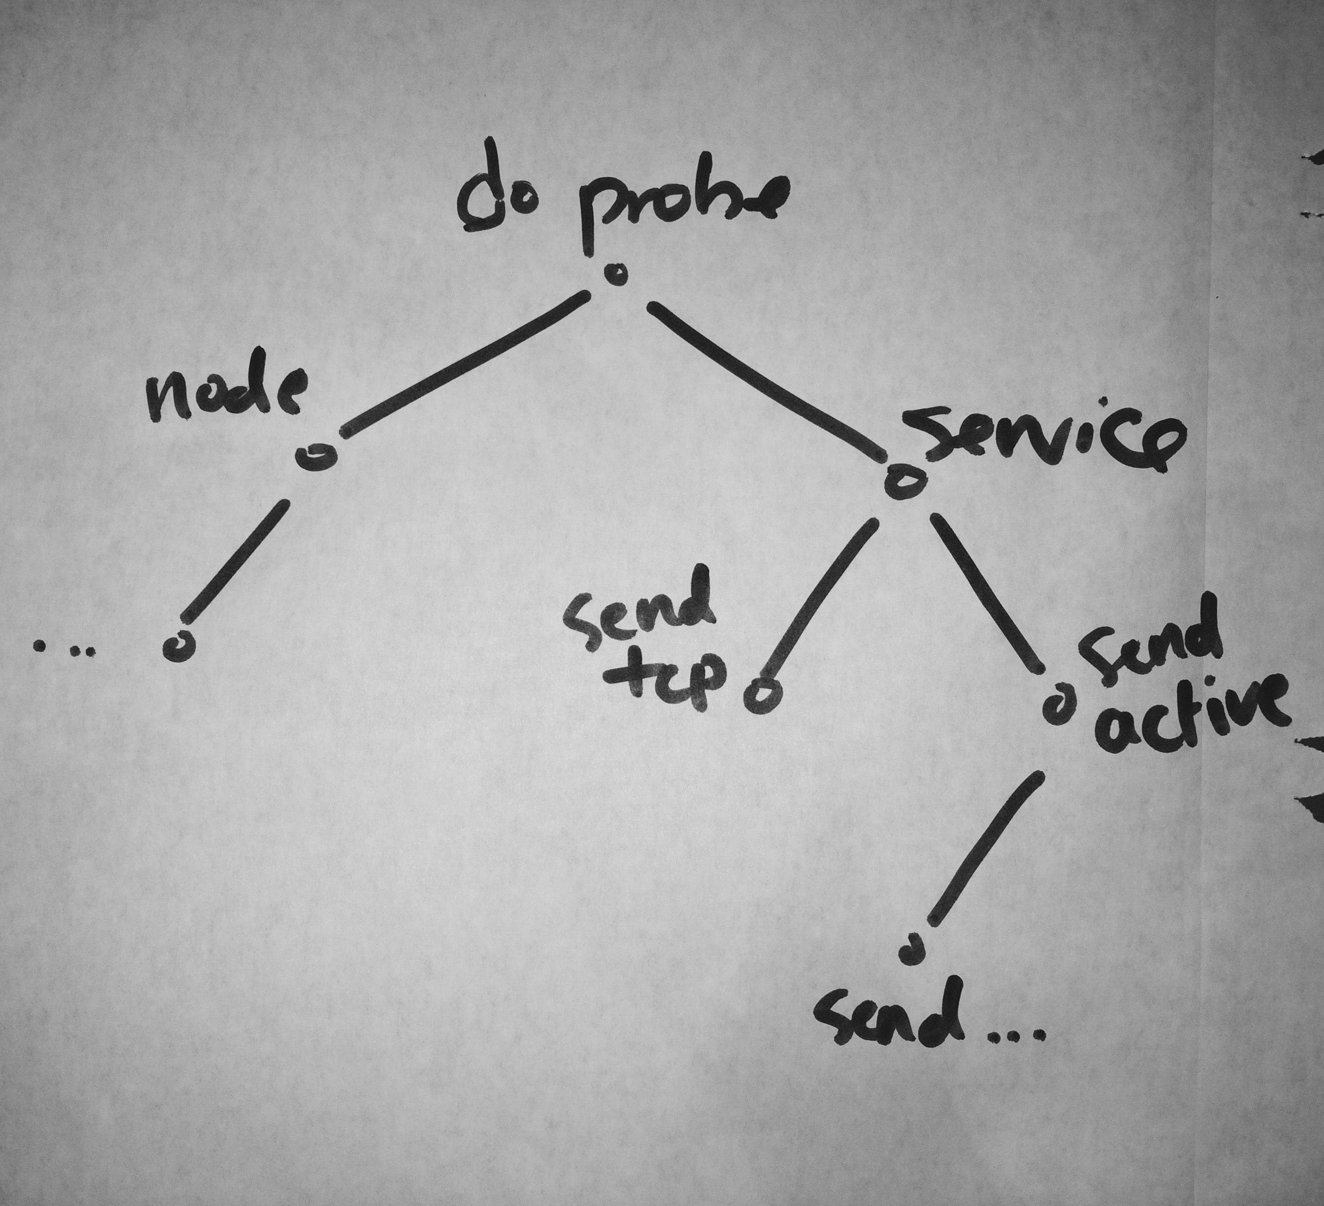
Example 3: Testing
Notes:
Just to quickly illustrate, here’s a subtree of functions…

Slide 25
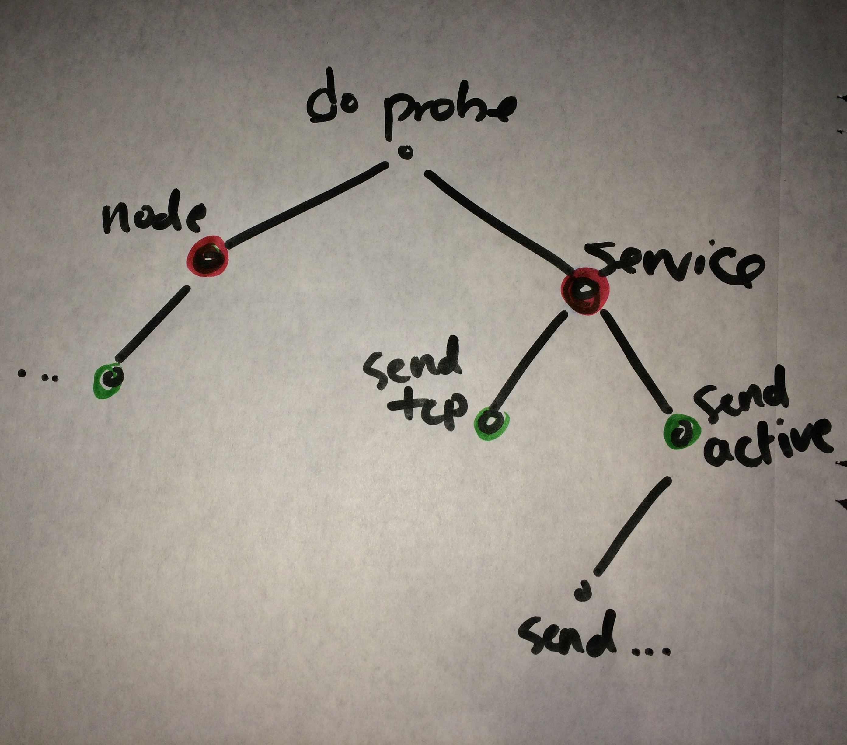
Example 3: Testing
Notes:
All the highlighted in green has socket or networking code, the red highlights external dependency to create a route domain context

Slide 26
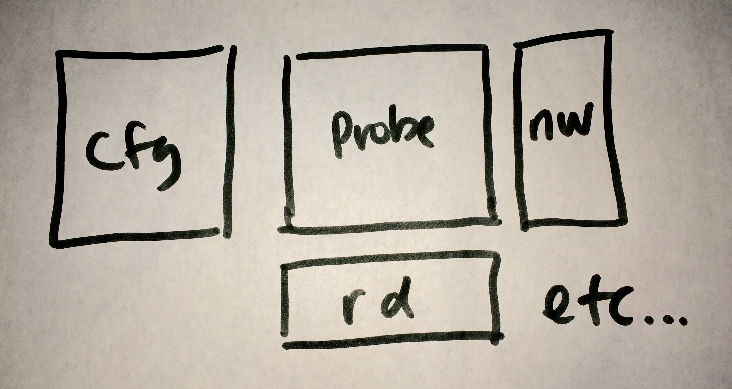
Example 3: Testing
Notes:
What we really want is for things to be better componentized – code centralized by functionality, and therefore easier to mock out

Slide 27
Example 3: Testing
Multi-Process example
Globals bad

Slide 28
Story 2: B20
How we got here
Newer concepts in industry
Notes:
Let’s say you’re a new company, called B20, and your pitch is “4 times the speed for ¼ of the price”. You want to quickly get to market, and so you create a basic L4 load balancer supporting only tcp and http protocols. You create the product, bolt on a shell, and push it to market. Your early adopters request a GUI, and so you create one using Angular, but it requires a different interface than the shell that’s more conducive to easier GUI development. Next you get bigger customers, and their enterprises require roles-based-authentication-control, and you quickly think the best way to implement security is through single UI surface, and so you redirect all GUI RBAC over to the shell. Before you know it, the growth in code starts to look very strange. In addition, newer concepts in technology pushes harder towards things like automation and consistent interfaces.
Nobody that is successful has a pristine code base – Shane Baker
The problems in code is really a microcosm of change in the broader organizational level

Slide 29
Not just code…
Serviceability
Cross-product compatibility
Documentation
Code Review
Product Team
Notes:
The entire product vision cannot be complete without contemplating quality. This includes making the product easier to test, serviceability, documentation, amongst others.
Serviceability: We think about serviceability from the perspective of customers as well as support. How easy is it for your customers to diagnose problems on their own? What information do you give to them that’s actionable? Are you publishing indecipherable error messages that requires knowledge of internals?
Documentation – “just read the code” is not an acceptable form of documentation. I want to know how to configure the product, what is the expected behavior, not just for developers, but for your customers. It might be the case with legacy code that there is no documentation, and over time, it’s not clear what customers can expect even in terms of supported performance and system limits.
We also think about Code Review processes. In our component, what are the main areas we want reviewers to focus on? In this story, we think of things like “networking/socket code”, or “configuration management”, or just “general C++ code review”. And for each, we define a rubric of items to review.
Forming a product focus team helps garner support for the roadmap, and delegates these tasks to a variety of stakeholders. It helps that if you want to modernize legacy code, you have to own it like an enterprise.

Slide 30
End / Questions

